Slide 1
Music for Stories
Generative Research Report
Marjorie Ann Cuerdo
HCI 445 - Winter Quarter
DePaul College of Computing and Digital Media
Initial Data Obtained: Winter 2019

Slide 2
“[Music] can propel narrative swiftly forward, or slow it down. It often lifts mere dialogue into the
realm of poetry. It is the communicating link between the screen and the audience, reaching out
and enveloping all into one single experience.”
— Bernard Herrmann, Film Composer

Slide 3
Overview
(Click on links below to jump to respective sections)
Note: Phases of study happened sequentially:
Observations -> Interviews -> Survey
Research Question
Executive Summary
Observations
Interviews
Themes
Survey Results
Design Implications

Slide 4
Main Research Question
What do digital content creators need to efficiently discover and edit music into their content, without requiring knowledge of music theory or composition?

Slide 5
Executive Summary
Music plays a key role in media-based stories. Despite its importance, there is often a gap between a creator’s musical expertise and their creative vision. In this project we asked: What are the needs of digital content creators to efficiently discover and edit music for their content, without requiring knowledge of music theory or composition? And how can a technology-based service scaffold this task?
Methods
We began this project with five observations of both experienced and inexperienced
digital content creators. We asked them to demonstrate how they find, edit and add
music to video. We took notes and recorded the participants’ actions.
We then interviewed five other content creators, both experienced and inexperienced.
Depending on their experience, we asked questions about their history with music and
video editing.
We then conducted an online survey to test our two hypotheses: (1) There is no
relationship among previous music/editing experience and perceiving the importance of
music in media; (2) Participants without editing experience are more likely to be
comfortable being assisted by artificial intelligence (AI) than participants with
experience.

Slide 6
Executive Summary
Results
We found from our observations that despite using different resources, participants went
through similar stages in their processes to find music and edit their content. We found
that different skill levels led to differences in their search and determination of what
music to use. We organized our findings into four themes: (1) similarities in workflow
processes, (2) difficulties in matching the motifs between audio and video, (3) the
inefficiency of finding and sorting through audio resources, and (4) copyright and
licensing issues.
We found from our interviews that all participants agreed that music was important and
impacted the emotional impact of the video. Participants had similar opinions of where
music would change in a video presented to them, based on the change in emotion,
mood or visual elements. We organized two themes from these findings: (1) knowledge
of the relationship between music and visual stories, and (2) frustrations with the overall
process.
We found that our survey results supported our first hypothesis, but rejected the second
hypothesis. Regardless of sound-based media editing experience, participants agreed
that music was important in media, and that they were comfortable with intelligent tools.
We also found that the greatest barrier of media editing for both experienced and
inexperienced participants was how time-consuming the process was.
Our findings had several implications for design, including a general intelligent media editing software that contains collaborative features and assistive guidance. Our research findings also support the need to improve the efficiency of discovering, editing and adding music for digital content creators. Our project was limited by the small sample size and the challenge of recruiting from a niche group (digital content creators).

Slide 7
Executive Summary
Design Implications
Our findings had several implications for design, including a general intelligent media editing software that contains collaborative features and assistive guidance. Our research findings also support the need to improve the efficiency of discovering, editing and adding music for digital content creators. Our project was limited by the small sample size and the challenge of recruiting from a niche group (digital content creators).

Slide 8
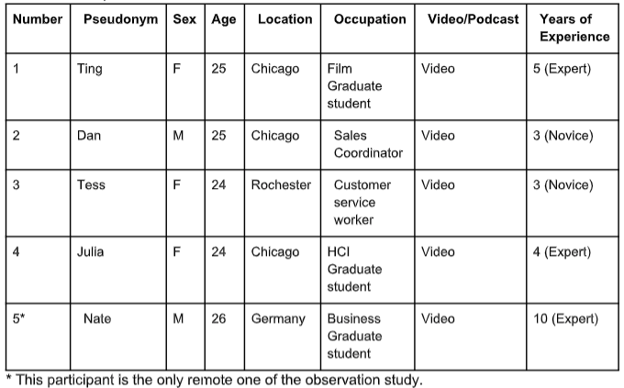
Observations - Participants
1 participant on Mac laptop and 4 on Windows laptop

Slide 9
Observations - Data Collection Methods
Prompt Description
Before observations started, a short interview was conducted about their previous media making experience. The following questions were asked:
What got you interested in making [Youtube videos/podcasts/whatever the participant does]?
How long have you been making [vids/pods/etc]?
What do you enjoy most about making [vids/pods/etc]?
What sort of planning goes into the development of these [vids/pods/etc]? Do you have a clear idea of the end product before you begin?
How large of a role would you say music and sound effects play in your [vids/pod/etc]?
They were then instructed to use their preferred media editing software to demonstrate their process of editing music and/or audio clips into their current multimedia project or a pre-selected video.
Other Details
Each session lasted between 10-30 minutes
Observations took place at participants’ homes and another at a library for their comfort and to elicit more natural behaviors
Sessions were screen-recorded with audio for future transcription and coding

Slide 10
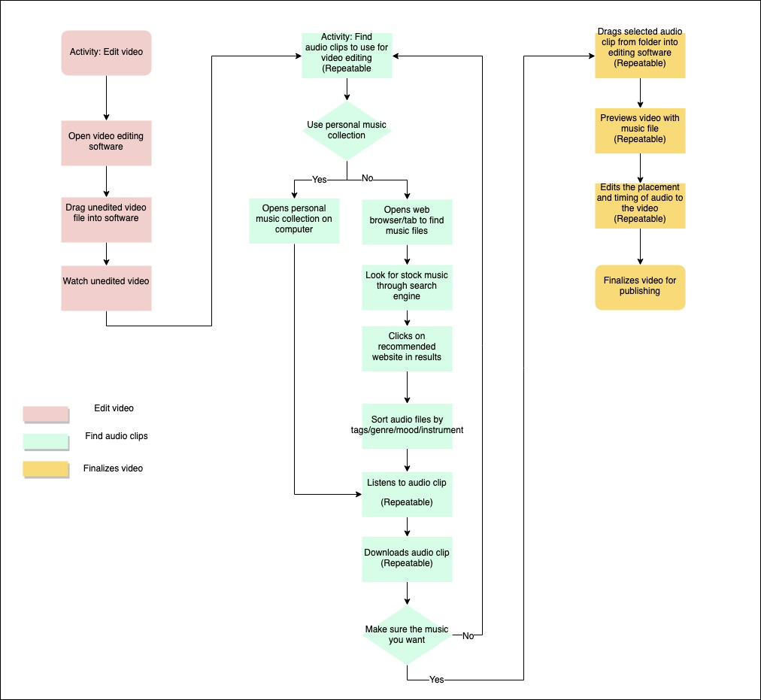
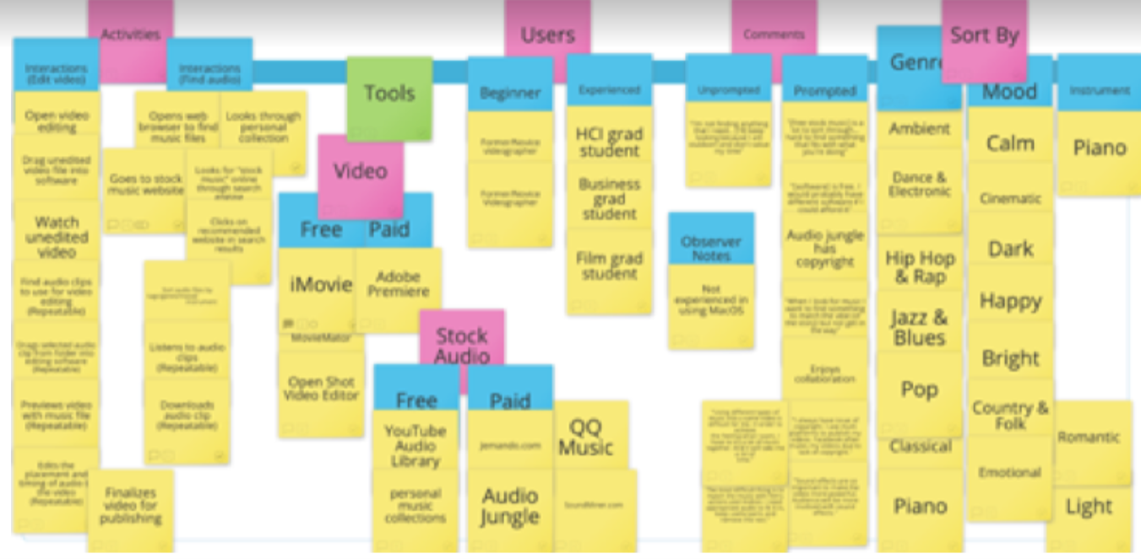
Observations - Analysis Methods
AEIOU Framework
AEIOU basically stands for Activities, Environments,
Interactions, Objects, and Users.
Main categories
Activities: Interactions -> Edit video, Find audio
Users: Beginner, Experienced
Objects: Tools -> Video, Audio -> Free, Paid
Sequence Model
Edit video -> Find audio clips/music (repeatable) ->
Drags selected audio into software to edit -> Publish

Slide 11
Themes from Observations
The content creation process was broken down into the following phases:
Watching video material
Searching for music
Comparing music
Editing for publishing
Experience levels (novice versus expert) determined the methods used within the phases

Slide 12
Interviews - Data Collection Methods
Semi-structured interview
Part 1: Participants were asked about their experiences finding music/audio and editing videos
With experience: They were asked about their content creation processes and preferred tools
No prior experience: We inquired about their interest in learning and if there are any existing barriers
Part 2: Participants were played an emotional video without music and imagine what music would match the visuals
They were then instructed to watch it again and pause whenever they felt a shift in music should take place and verbally describe it
Afterwards, the actual video with audio was played and participants gave feedback on their compatibility.
Individual sessions in-person
Each session was about 30 minutes
Recorded for transcription later

Slide 13
Interviews - Analysis Methods
Inductive Coding
Used Atlas.ti to code the interview transcriptions
Team discussion (4 researchers) to group codes into themes
Common characteristics were represented as spectrums (low - high),
depending on level of experience

Slide 14
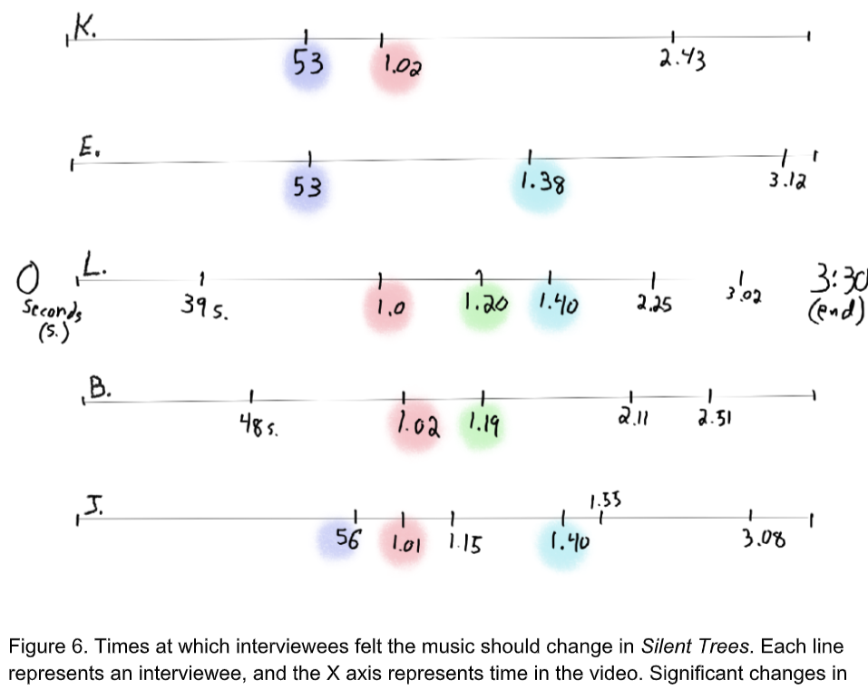
Themes from Interviews
Knowledge and use of existing music resources
Current editing processes/workflows
Music follows a story
Obtaining inspiration for creativity
Editing tools
Relationship of music and stories - - - - - - - - - - - ->
Barriers in finding and editing content
Process is time-consuming
Limited organization of music resources
High costs for professional options

Slide 15
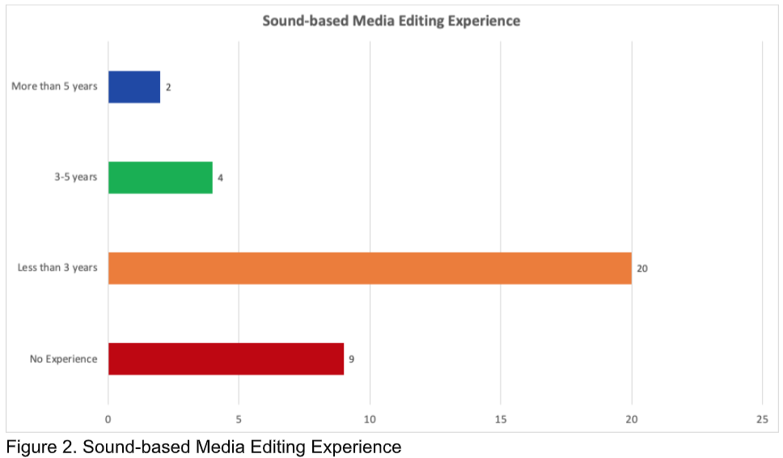
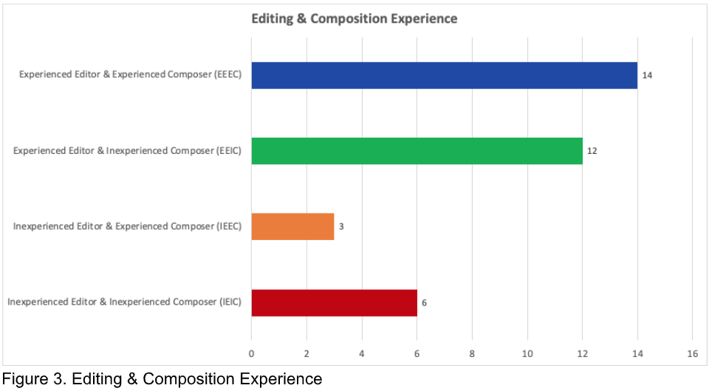
Survey - Participants
Recruited through DePaul University’s CDM/COMM participation pool, DePaul HCI Facebook group, and personal connections
Screener:
Over 18 years old
Have experience with or desire to be a content creator that will need music in their work
Total of 43 responses, cut down to 35 valid responses
Gender breakdown:
19 female, mean age 25.47 years old of 18-48 years range
16 male, mean age 21.63 years old of 18-27 years range
Experience

Slide 16
Survey - Data Collection Methods
Survey developed and distributed through Qualtrics (rating system is Likert scale out of 5)
Questions focused on the following areas:
Experience level of sound-based media editing and music composition/arrangement
We then branched to respective paths for experienced and inexperienced editors:
Experience editors
List preferred editing software, rate satisfaction levels, and identify its good and bad features
Identify music resources and their good and bad features
Inexperienced editors
Rate interest in learning interest and any present barriers
We asked all participant groups to answer the following sections:
Importance of music and sound effects in media
Comfort level using Artificial intelligence (AI) tools
Identify features they desire in an intelligent tool to assist editing music/audio for content creation
Demographics

Slide 17
Survey - Analysis Methods
Atlas.ti used again for open coding of written responses
Statistics tools: Excel and SPSS
Hypotheses derived from previous observation and interview findings:
There is no relationship among previous music/editing experience and perceiving the importance of music in media.
Participants without editing experience are more likely to be comfortable being assisted by artificial intelligence than participants with experience.
Mann-Whitney U tests for statistical tests

Slide 18


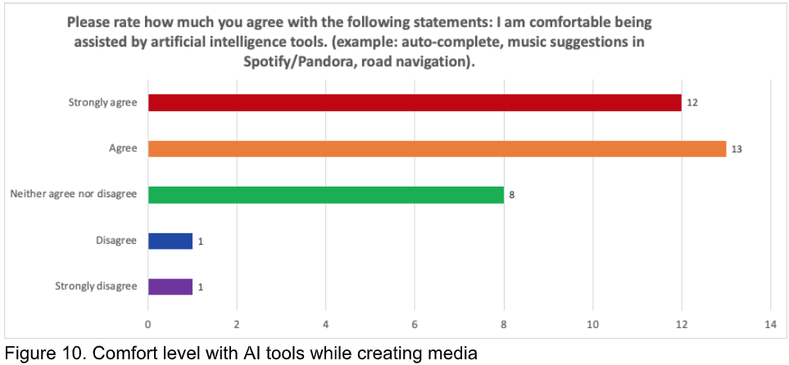
Survey - Results
Testing hypotheses using Mann-Whitney U tests
There is no relationship among previous music/editing experience and perceiving the importance of music in media.
Participants without editing experience are more likely to be comfortable being assisted by artificial intelligence than participants with experience.
Regardless of experience level,
most participants agreed music is important in media.
There was no significant difference among experience groups with comfort levels for AI assistance. Most agreed they were comfortable with AI.

Slide 19
Survey - Results
We wanted open, imaginative responses about desirable features in AI editing software
Features:
Personalized recommendations
Search assistance
Faster process
Automatic editing and timing
User confirmation of AI suggestions

Slide 20
Design Implications
Speculative design ideas
Intelligent editing software
Video genre identification and music suggestions to cut down time
Audio-focused search feature
Input information: genre, emotions, atmosphere, or phrases (e.g. “sad dying dog”)
Inspiration gathering
Automatically detected genre of video outputs related videos, audio, and art
Suggested markups for mood changes/shifts
Copyright misuse prevention
Display files’ current copyright status and link to purchase if needed
Collaboration features
Live collaboration
Assign sections or tasks to members
Edit and accept/reject suggestions
Tutorials and guidance
Assistive features to guide editing process for novices

Slide 21
Thank you for your attention!
If you would like to see the materials used in this research, please refer to the Appendices section (starting pg. ) in this document that was submitted for my User Research Methods class:
https://drive.google.com/open?id=1QKYbLW3L26GZLcUmMkPaAxoii2oF2TXa

